Slide 1
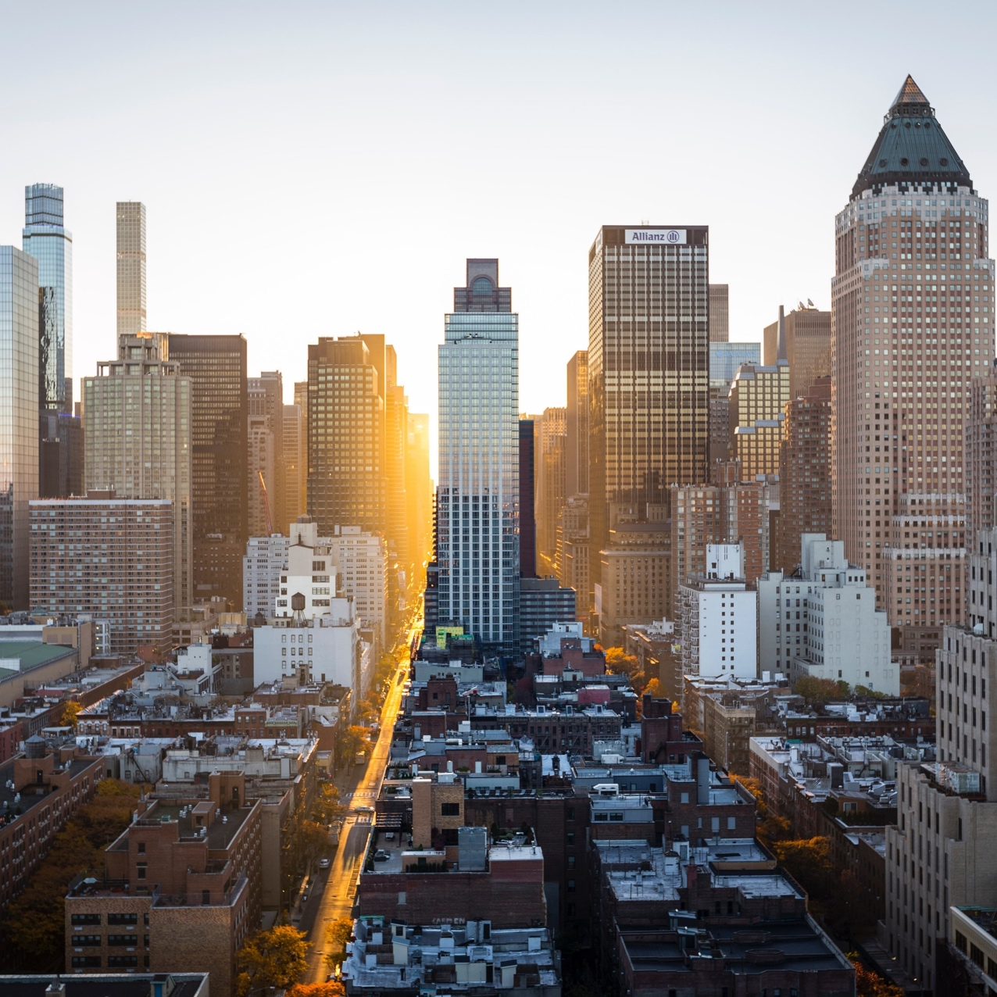
BATTLE OF NEIGHBORHOODS ibm Data Science Professional Capstone project
Felix reznitskiy, December 24th 2020

Slide 2
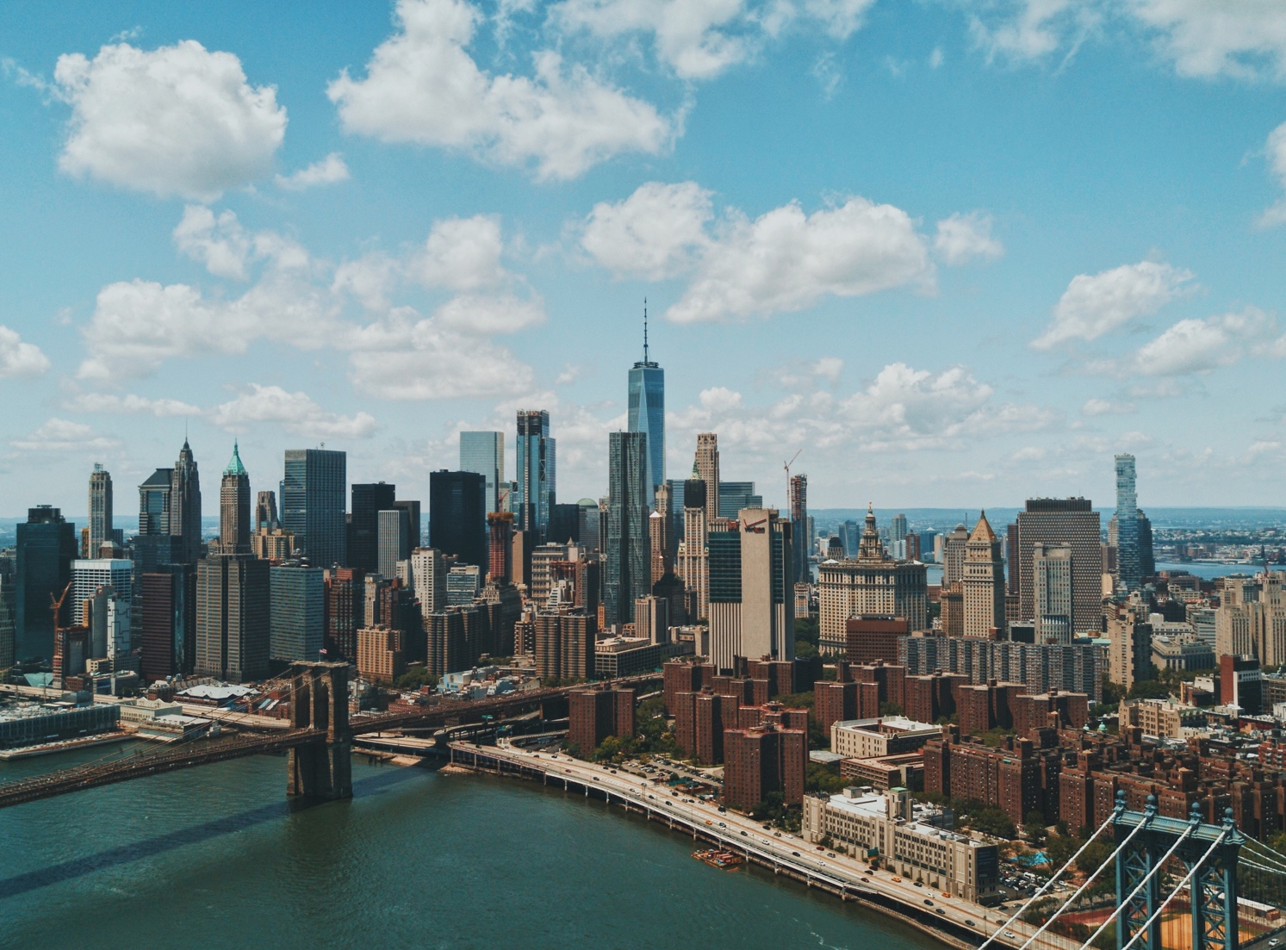
Coffee Lovers guide to America
Comparing five major US cities

Slide 3
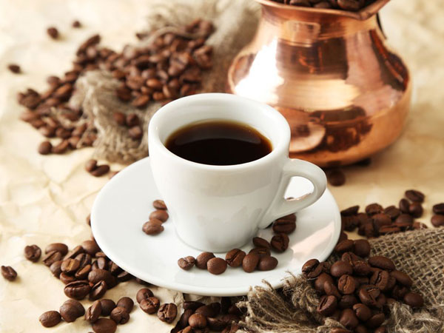
Introduction
Coffee first became popular in the U.S. after the Boston Tea Party, when the switch was seen as “patriotic,” according to PBS. And since Starbucks debuted in 1971, the drink is now accessible almost anywhere you go. A recent survey by the National Coffee Association found that 62 percent of Americans drink coffee every day, with the average coffee drinker consuming 3 cups daily. What gave way to java culture? Science, for one, has convinced us that caffeine possesses multiple health benefits besides mental stimulation. At the right dosages, caffeine may contribute to longevity. Perhaps just as important, though, is coffee’s social purpose.
Today, coffee stations are a staple of the workplace, and tens of thousands of shops serve as meeting places for friends, dates and coworkers – though in 2020 many have had to provide take-out service only due to the COVID-19 pandemic.

Slide 4
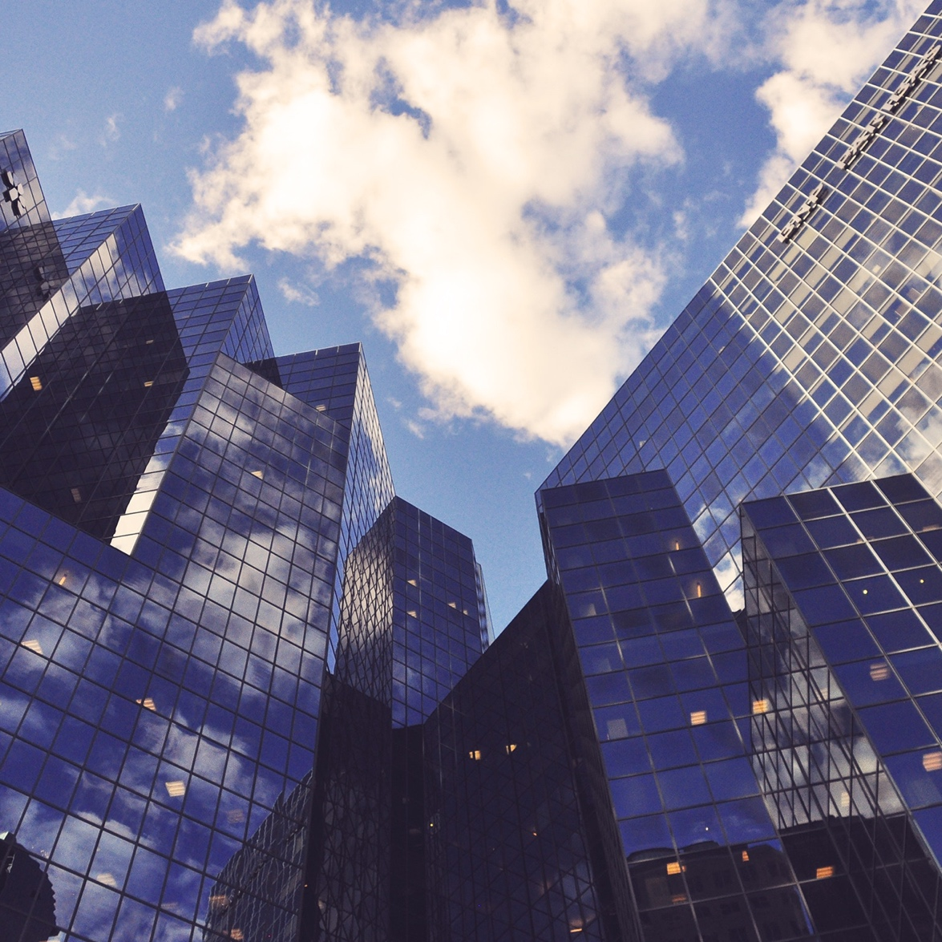
Business Problem
Our customer wants to open a coffee beans roasting facility in one of the major US cities.
In order for the new business to be successful, he needs to find the best location for the new place. Therefore, we are requested to find the city and the neighborhood with the highest density of coffee shops.
To determine the best city for the new business, we will find a major city with the highest density of coffee shops out of five major US cities.
Next, we will compare the neighborhoods to determine the one with the highest density.

Slide 5
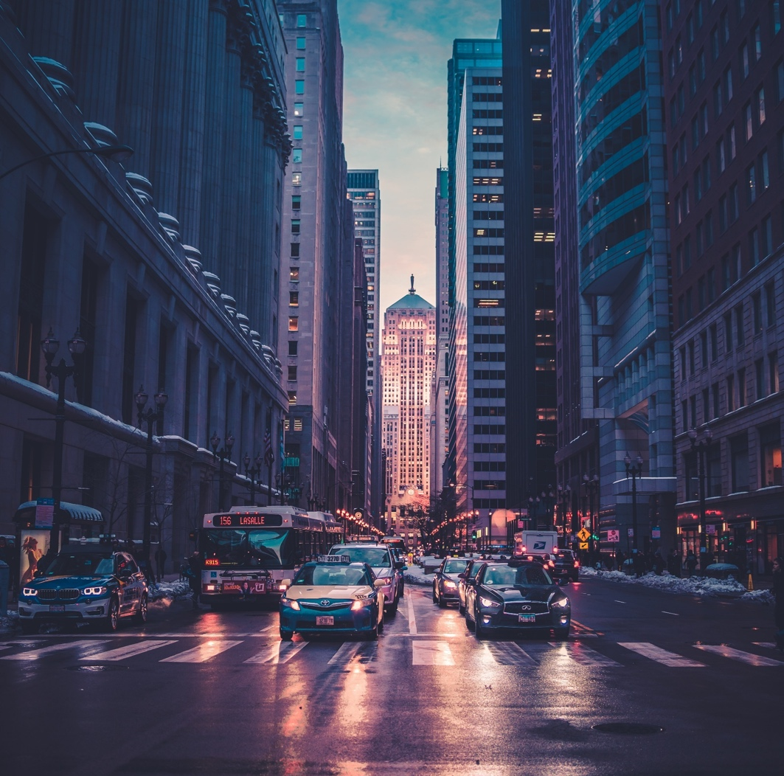


Solution
PARt 1
part 2
To determine the best city for the new business, we will find a major city with the highest density of coffee shops out of five major US cities:
New York City, NY (Population: 8,622,357)
Los Angeles, CA (Population: 4,085,014)
Chicago, IL (Population: 2,670,406)
Houston, TX (Population: 2,378,146)
Phoenix, AZ (Population: 1,743,469)
We will use basic statistics methods for finding the mean coordinates and average distance from venues to the mean coordinates / city center location.
Therefore, the city with the lowest mean distance will be considered as the best.
After the best city is found, we will use K-Means clustering to visualize the neighborhoods with the highest density of coffee shops on the city map.
We are going to utilize the Pandas dataframes and Folium maps to cluster the venues and present the findings on the map.
Five neighborhoods with the highest density of coffee shops will be considered winners and will be presented at the final map.

Slide 6


Finding the best city
We need to make sure we are fetching only coffee shops during the Foursquare API search. We will run Foursquare API once, and we will fetch one coffee-shop from one city in order to extract the category Id of "Coffee Shop". This Id will be used to limit the search and fetch only one venue category.
category name
category Id
After the city center information and category Id are fetched, we will run the FourSquare API search query and pull the list of coffee shops for each city:
venue name
venue category
latitude
longitude
geocoders
We require geographical location data for each of the five cities. City center information will be used as a starting point for the FourSquare API (we will run search query around particular geographical location). We will use geopy.geocoders to obtain the city center coordinates for each of the five cities:
city
latitude
longitude
Foursquare API

Slide 7
Finding the best city
Then we will display each city’s venues on the Folium map in order to visualize the density.
Please see the upcoming slides for the maps.
Foursquare api - CONTINUED
As mentioned above, we will fetch data about coffee shops in 5 largest US cities:
New York City, NY
Los Angeles, CA
Chicago, IL
Houston, TX
Phoenix, AZ
visualization

Slide 8
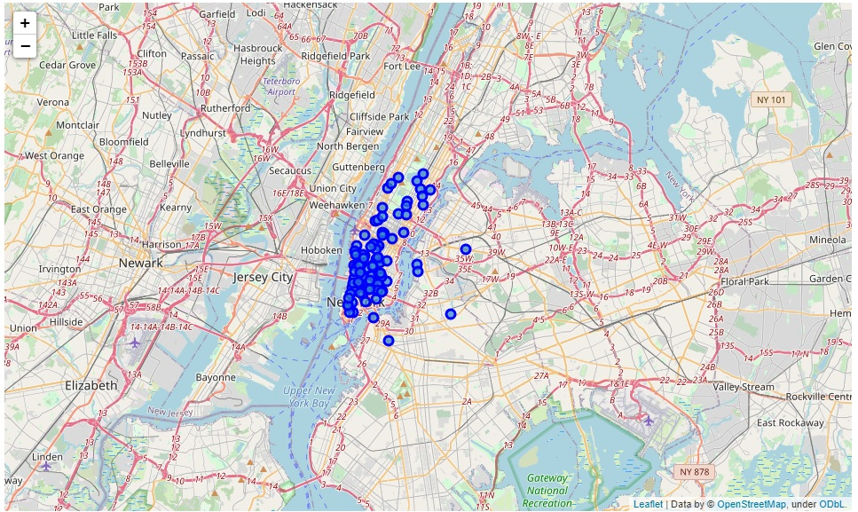
display each city’s venues on the map in order to visualize the density NEW YORK, ny
Total number of coffee shops: 220

Slide 9
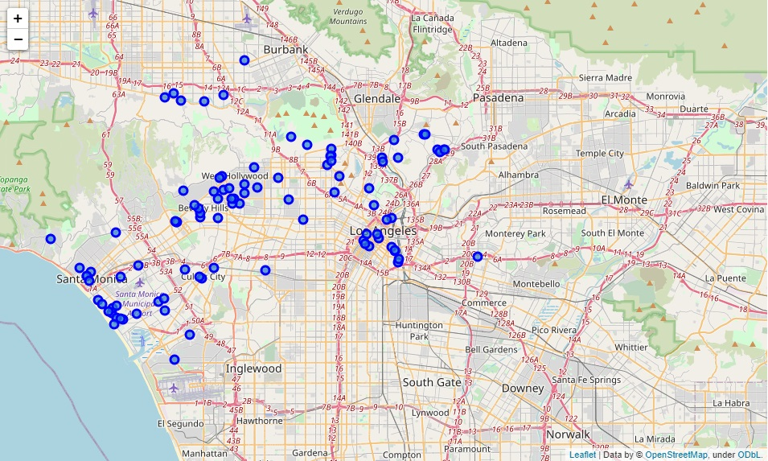
display each city’s venues on the map in order to visualize the density Los Angeles, ca
Total number of coffee shops: 201

Slide 10
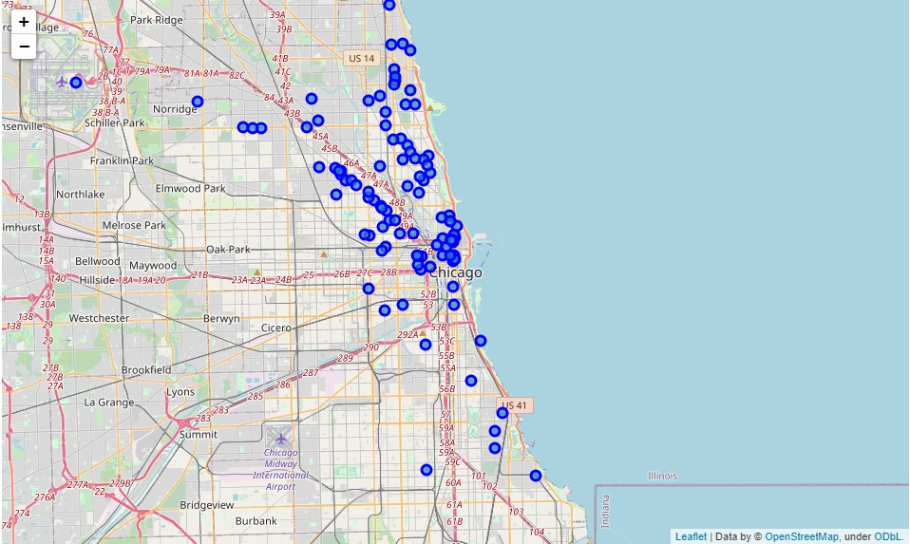
display each city’s venues on the map in order to visualize the density Chicago, il
Total number of coffee shops: 184

Slide 11
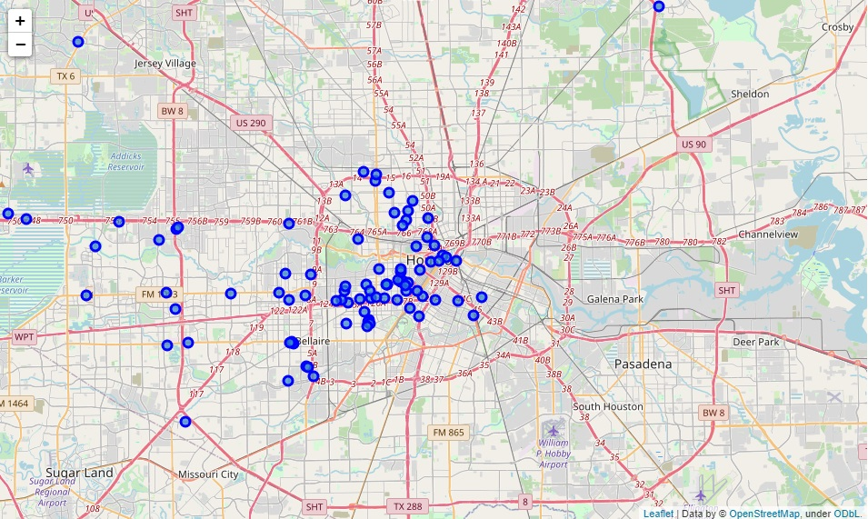
display each city’s venues on the map in order to visualize the density Houston, tx
Total number of coffee shops: 156

Slide 12
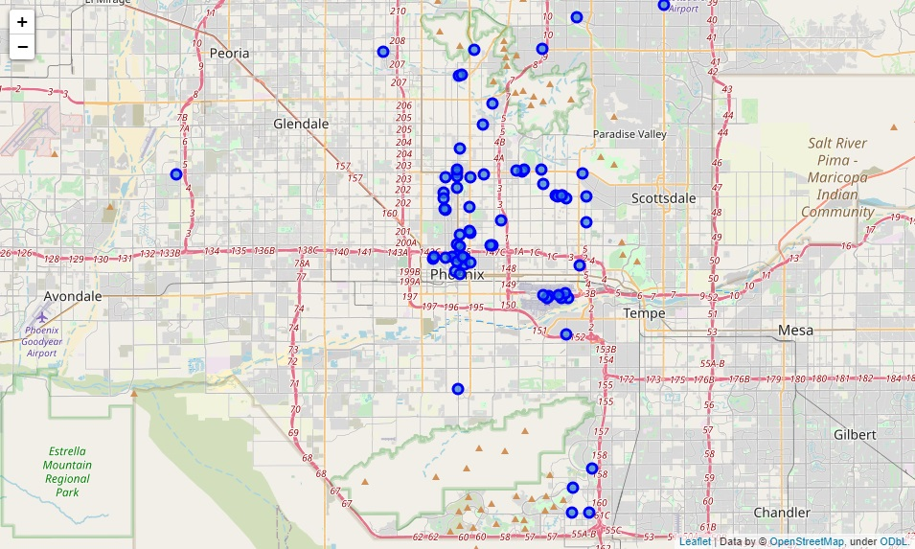
display each city’s venues on the map in order to visualize the density phoenix, AZ
Total number of coffee shops: 161

Slide 13
FINDING THE BEST CITY – TABLE OF RESULTS
We can see that New York and Chicago have the highest density of coffee shops.
In order to justify the above observations, we will measure the density and create a table with the concrete numbers. Let's use two methods of calculations - we will calculate average distance from coffee shops to the corresponding city center, and also average distance of the venues to their mean coordinates.
# | CITY | Average Proximity To The City Center | Average Distance To Mean Coordinates | Coffee Shops Per City
0 | New York, NY | 0.032317 | 0.022257 | 220
1 | Chicago, IL | 0.072158 | 0.054008 | 184
2 | Houston, TX | 0.115663 | 0.106295 | 156
3 | Phoenix, AZ | 0.128295 | 0.117186 | 161
4 | Los Angeles, CA | 0.136265 | 0.099407 | 201
CONCLUSION: We can see that New York has the highest density of coffee shops.
Therefore, we pronounce New York the best city for coffee lovers!!!

Slide 14
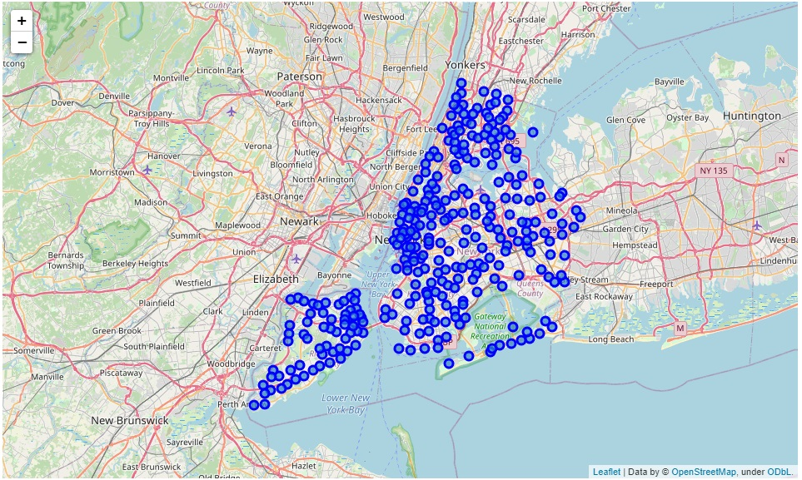
Part 2. Finding the best neighborhoods
Let's cluster the NY neighborhoods in order to find the ones with the highest density.
New York has a total of 5 boroughs and 306 neighborhoods. Let’s look at the map.

Slide 15
Top borough and its neighborhoods: Manhattan

Slide 16
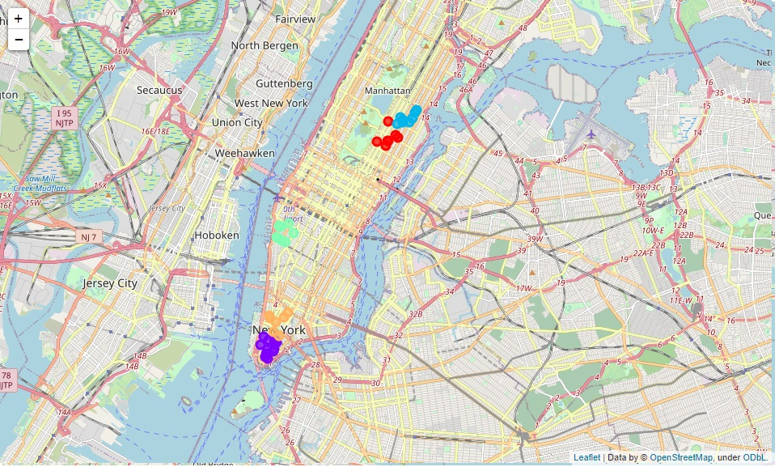
Part 2. Finding the best neighborhoods
Let’s run k-means to cluster top five Manhattan neighborhoods according to the previous slide.
Next, we will display the results on the map.

Slide 17
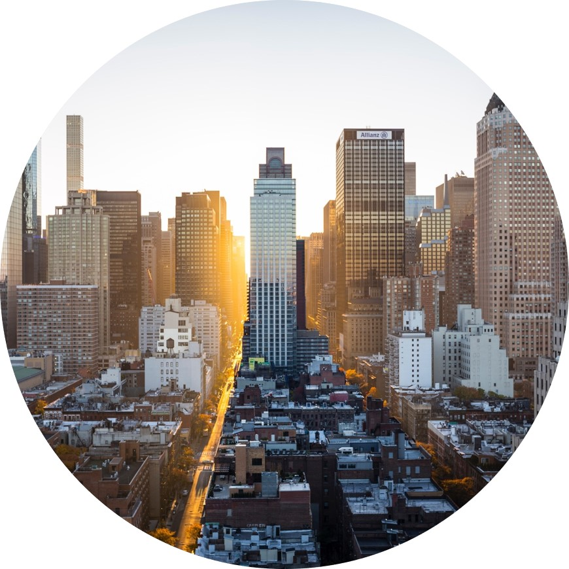
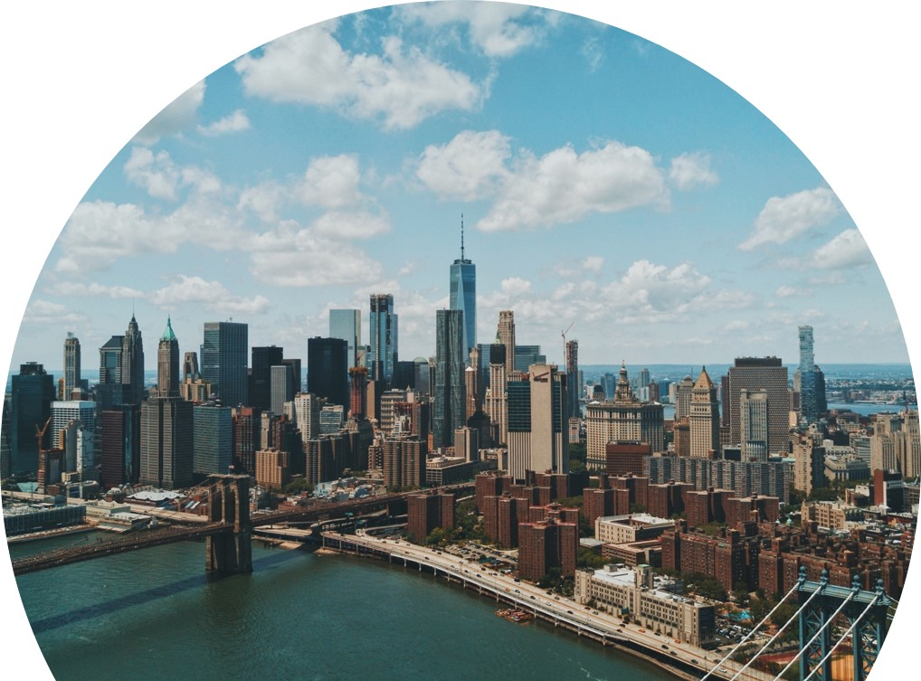
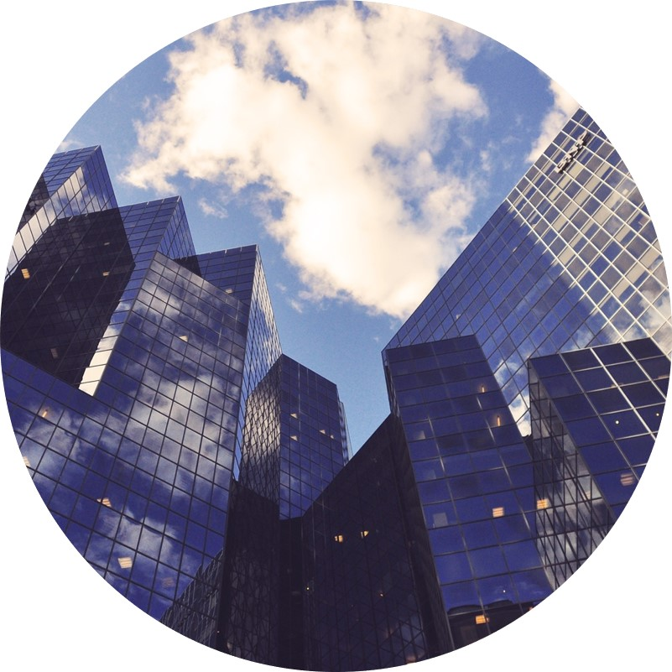
conclusion
Based on the analysis results, the most attractive area for the new coffee beans roasting facility is Manhattan, and it’s five neighborhoods below:
Best city
BEST BOROUGH
TOP FIVE NEIGHBORHOODS
NEW YORK, NY
MANHATTAN
Financial District (12)
Carnegie Hall (8)
Chelsea (8)
Civic Center (7)
Upper East Side (7)

Slide 18
Thank you
Felix.rez@gmail.com

